Slide 1
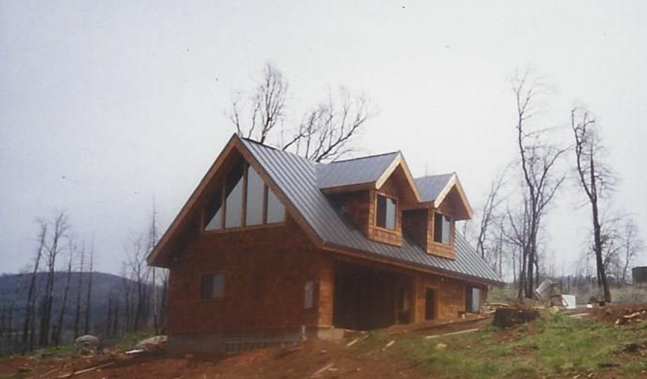
Jeff Morrow- Post Fountain Fire Accessory Dwelling Unit (ADU) Survivor
1204 Willis Street
General Contractor # 706844
Affordable Housing Associates
www.bigsmallhouses.com

Slide 2
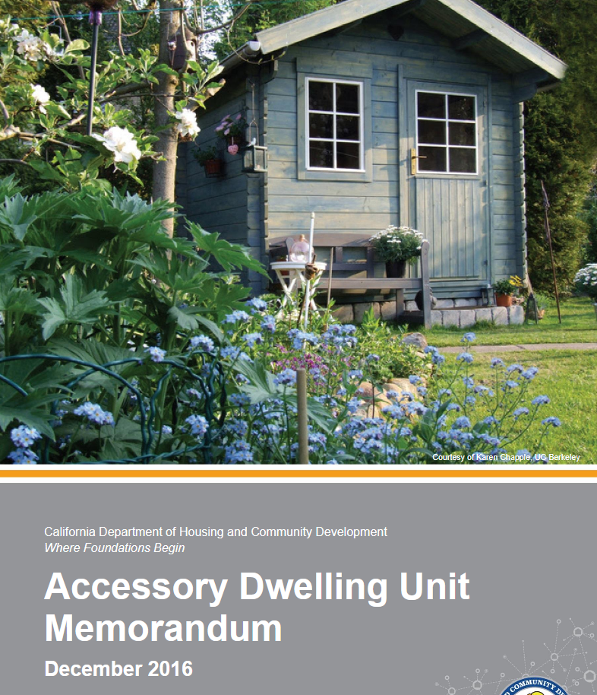
ACCESSORY DWELLING UNITS (ADU)
A new term describing a habitable structure allowed by right, subject to encouraging state regulation.
Gone are terms like granny flat, 2nd unit, pool house, or grandfathered in.
Accessory Dwelling Units are accessory structures converted or constructed for living, including kitchen, bath, and sleeping quarters; within spaces smaller than previously contemplated and in structures previously not allowed.
Cover photo features
tiny home?

Slide 3
STATE ADU REGULATIONS… DEREGULATE ADUS. Local ADU Ordinances Must Comply.
§65852.150 (b) It is the intent of the Legislature that an accessory dwelling unit ordinance adopted by a local agency has the effect of providing for the creation of accessory dwelling units and that provisions in this ordinance relating to matters including unit size, parking, fees, and other requirements, are not so arbitrary, excessive, or burdensome so as to unreasonably restrict the ability of homeowners to create accessory dwelling units in zones in which they are authorized by local ordinance.

Slide 4
REGS CONTAIN A WORK AROUND?! ADUs shall be allowed. Why did Affordable Housing Associates fail in 3 of 3 ADU submissions? Why? Redding’s ADU ordinance has problems.
§ 65852.2 (e) Notwithstanding subdivisions (a) to (d), inclusive, a local agency shall ministerially approve an application for a building permit to create within a zone for single-family use one accessory dwelling unit per single-family lot if the unit is contained within the existing space of a single-family residence or accessory structure, including, but not limited to, a studio, pool house, or other similar structure, has independent exterior access from the existing residence, and the side and rear setbacks are sufficient for fire safety.

Slide 5
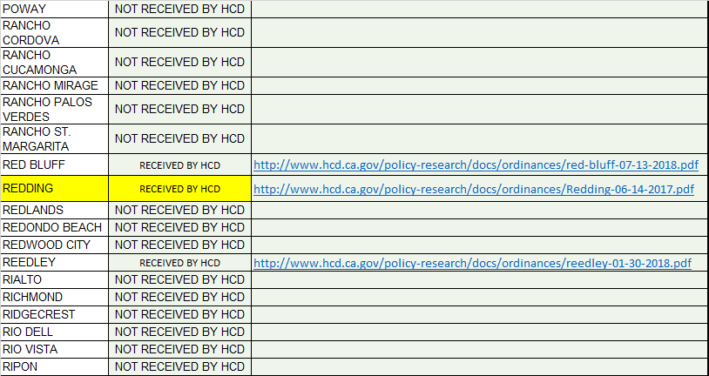
REDDING INVESTED IN A LOCAL ADU ORDINANCE, MANY JURISDICITONS DID NOT.
JURISDICTIONS NOT SUBMITTING A LOCAL ADU ORDINANCE DEFER TO STATE ADU LAW.
Ordinances are not reviewed. Submission does not indicate compliance.
Source: http://www.hcd.ca.gov/policy-research/AccessoryDwellingUnits.shtml#ordinance

Slide 6
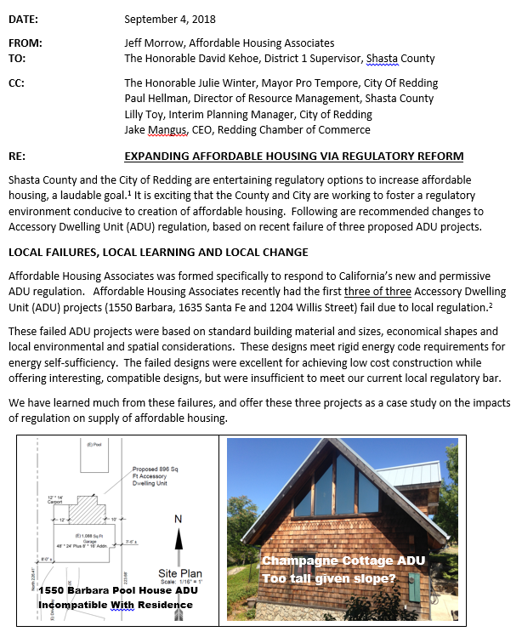
Issues surrounding Redding’s ADU law raised:
1) ADU if no single family (post fire housing issue)
2) Size Limitation (500 s.f. minimum vs 150 s.f. state)
3) Lot Size: (No downtown neighborhood ADUs)
4) Height Limitations (Story and a half construction)
5) Neighborhood compatibility vs residence similarity
6) Owner Occupancy Restrictions 7) Short term rental prohibitions
8) Developer fees if under 500 square feet
9) Phased construction
10)Homelite COR fees
Additionally:
Accessory structure conversion Replacement of covered parking Lofts, ladders, and attic space
Appendix Q, California Building Code amendments Plus: New $75 affordable housing recording fee

Slide 7
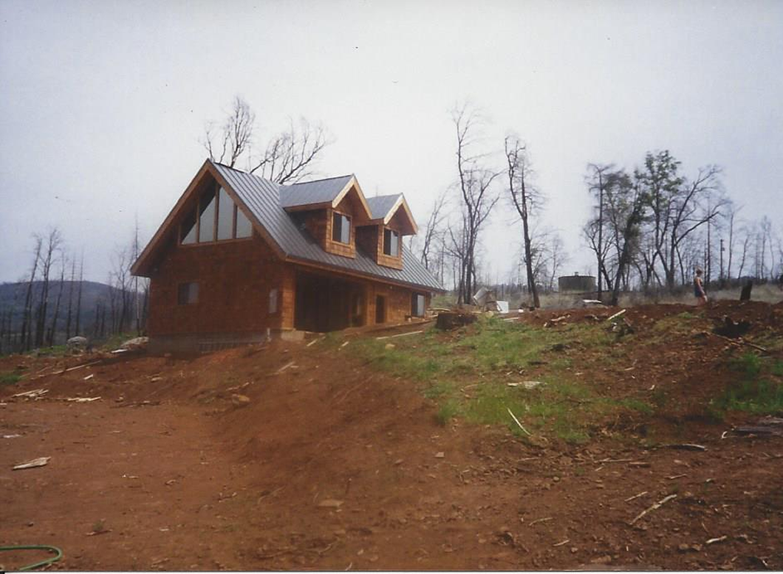
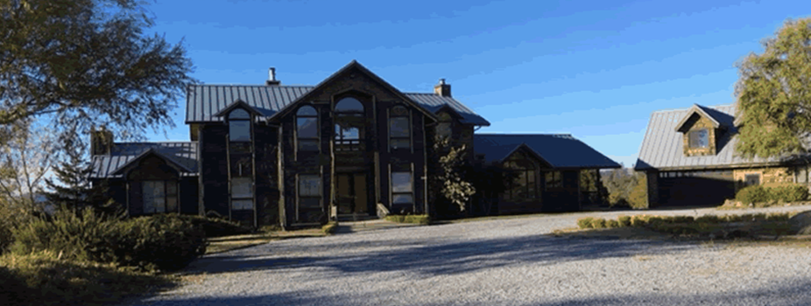
Issue #1 of 10-
No ADU if no single family residence?
Reasonable post-fire concern for planners.
Shown is an example of a post-fire ADU, followed by a residence.

Slide 8
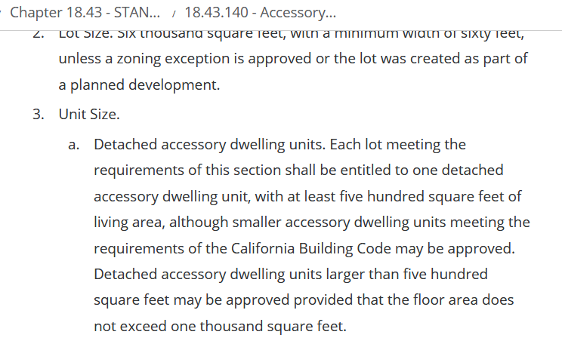
Issue #2 of 10 Unit Size
Redding’s ordinance requires 500 square feet, while state
law mandates at least an efficiency unit be allowed, which is 150 square foot minimum.
§ 65852.2 (c) ”A local agency may establish minimum and maximum unit size requirements for both attached and detached accessory dwelling units. No minimum or maximum size for an accessory dwelling unit, or size based upon a percentage of the proposed or existing primary dwelling, shall be established by ordinance for either attached or detached dwellings that does not permit at least an efficiency unit to be constructed in compliance with local development standards.”

Slide 9
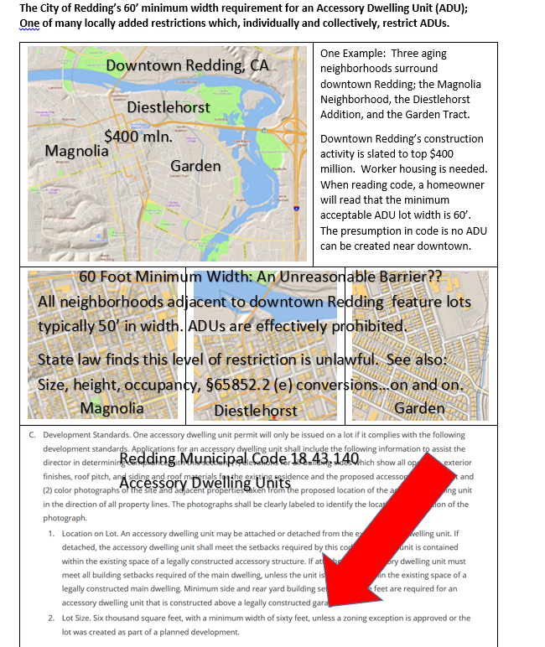
Issue #3 of 10: The sixty foot lot rule.
California’s guiding philosophy describing ADUs is to
“not unreasonably restrict the ability of homeowners to create ADUs. Standards…must not be designed or applied in a manner that burdens the development of ADUs and should maximize the potential for ADU development.”
(Source: HCD Memoranda on ADUs)
The sixty foot rule prohibits ADUs in residential districts that would otherwise allow an ADU.
An example of lack of compliance? Absolutely.
3 of 3 from a list of ten (10) indicates compliance issues.
Simply, having so many issues relative to ADUs in Redding burdens the development of ADUs.

Slide 10
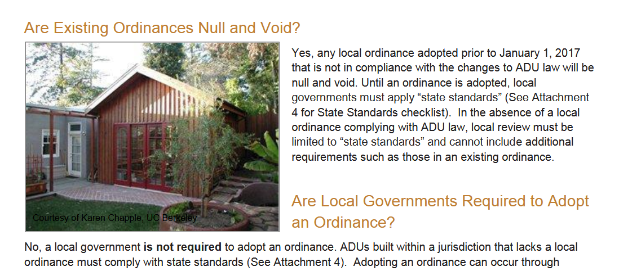
What does Housing and Community Development say about non-compliance with state law?
? Similarity?

Slide 11
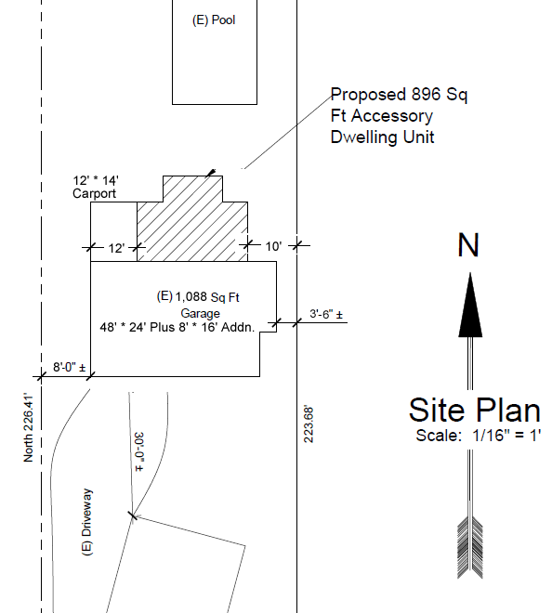
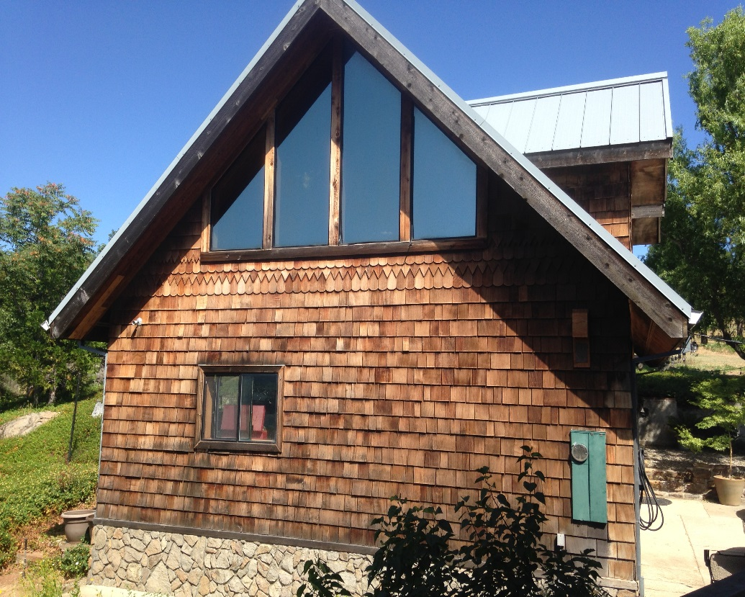
A regulatory problem exits. The problem leads to an affordable housing crisis, homelessness, and blight.
What to do about this regulatory problem? Will this problem be addressed?
Who will address the problem? When will this problem be addressed? How will this problem be addressed?
One solution: Adopt State law. Positive outcomes will flow, including solutions for the homeless, cash flow support for homeowners, and affordable housing options for the disabled.
HELP!!! Confusion
And
Uncertainty
Reign

Slide 12
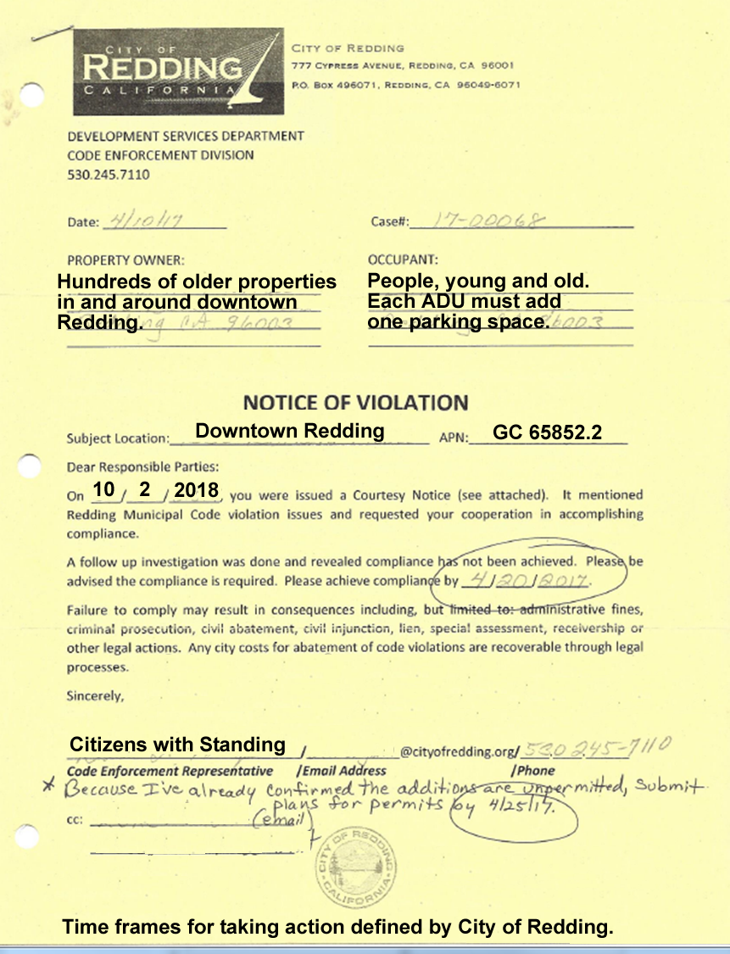
Address regulation of ADUs in Redding.
Adopt state law.
Support housing options for Ashley.
Build ADUs, NOW!

